Slide 1
Exploring Artificial Intelligence Futures
Shahar Avin
Centre for the Study of Existential Risk (CSER)
University of Cambridge
sa478@cam.ac.uk

Slide 2

What is AI?
Unfortunately named
Compare to “artificial heart”
An artifact that can perform a task that requires intelligence in animals
Narrow versus General

Slide 3

The Turing Test
An early vision of AI (1950)
Inspired by the Victorian Imitation game
Subjectively judged on performance
Within a well defined environment
No limitations on solution method
Not solved, but significant progress made

Slide 4
Machine Learning
A subfield of AI
Breaks away from previous conceptions of AI as “logic”, “rule-based”
Better viewed as automated statistics / pattern recognition
Decreasing reliance on human expertise (though still essential)
https://xkcd.com/1838/

Slide 5
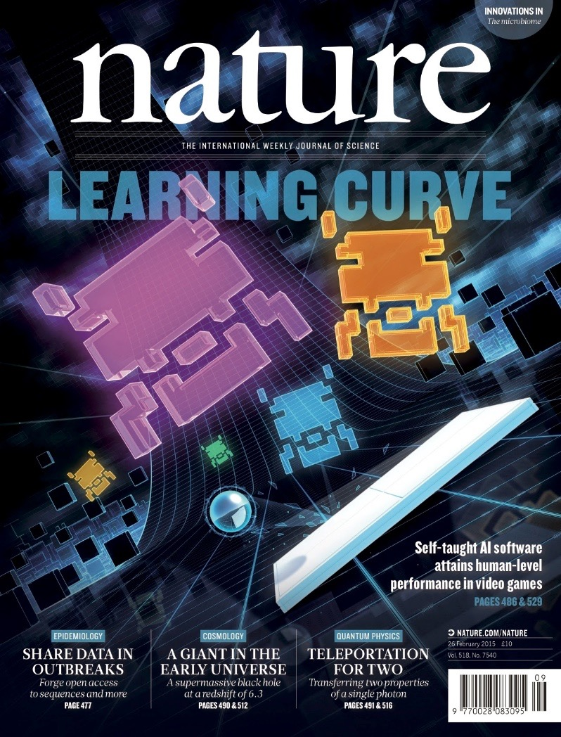
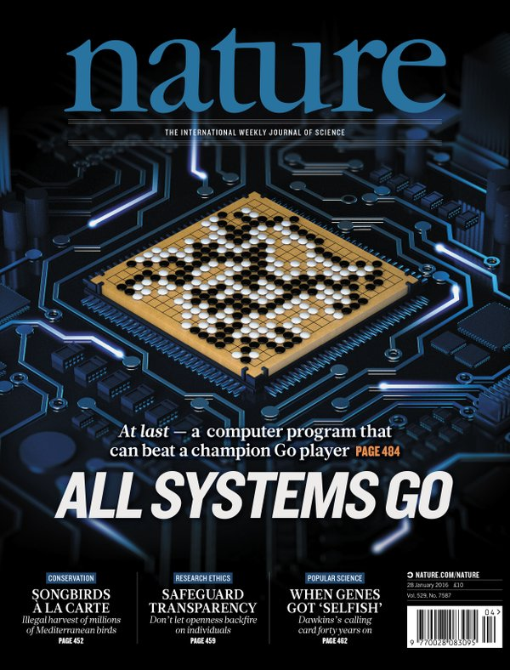
Deep Neural Networks
Reinforcement learning
Self-play Search
Supervised learning Transfer learning

Slide 6
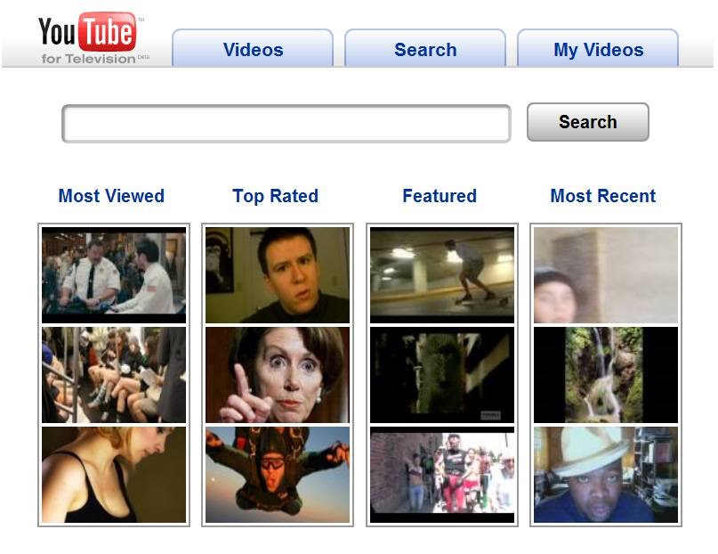
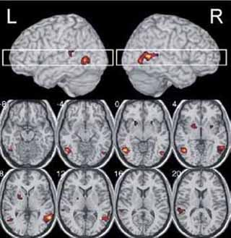
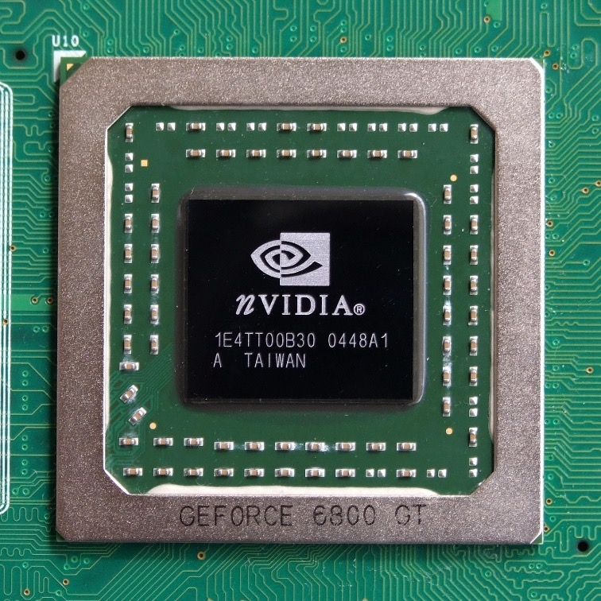
The necessary ingredients
Architectures and training algorithms
Computing power
Data and/or simulators

Slide 7
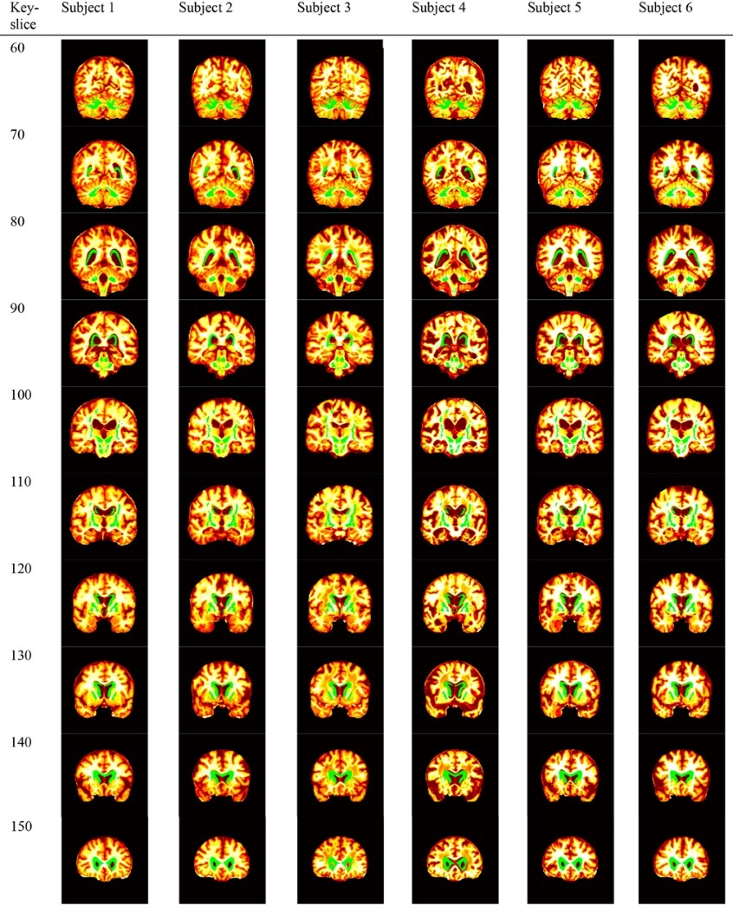
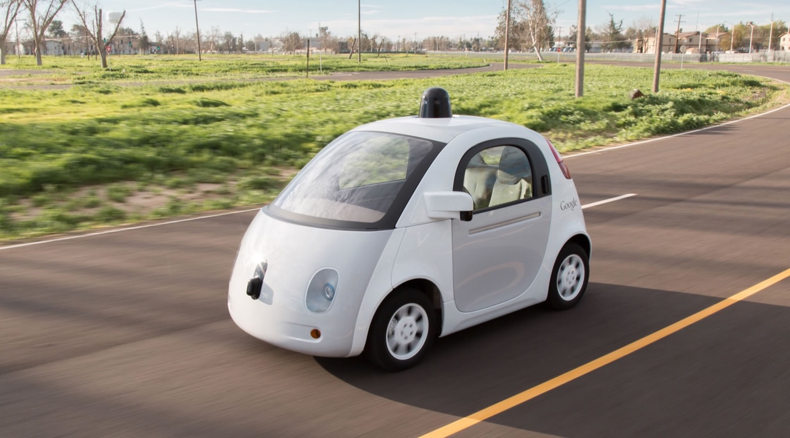
Near future
Self-driving cars
Augmented reality machine translation
Medical diagnosis

Slide 8
Also in the near future
Automated cyber attacks
Learning robots
Real-time sentiment analysis and adaptive messaging
High level forgeries of sound, images, videos, writing styles, news

Slide 9
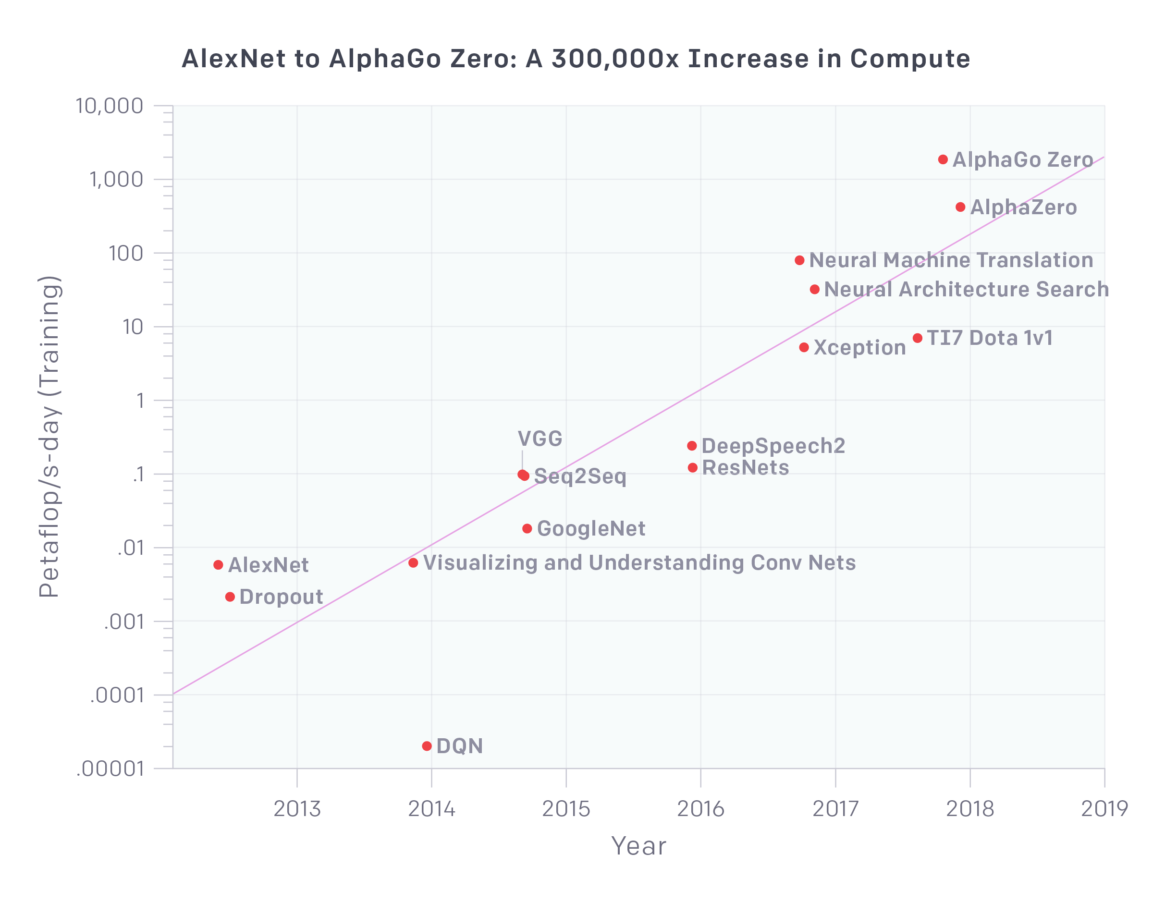
Exponential growth
https://blog.openai.com/ai-and-compute/

Slide 10
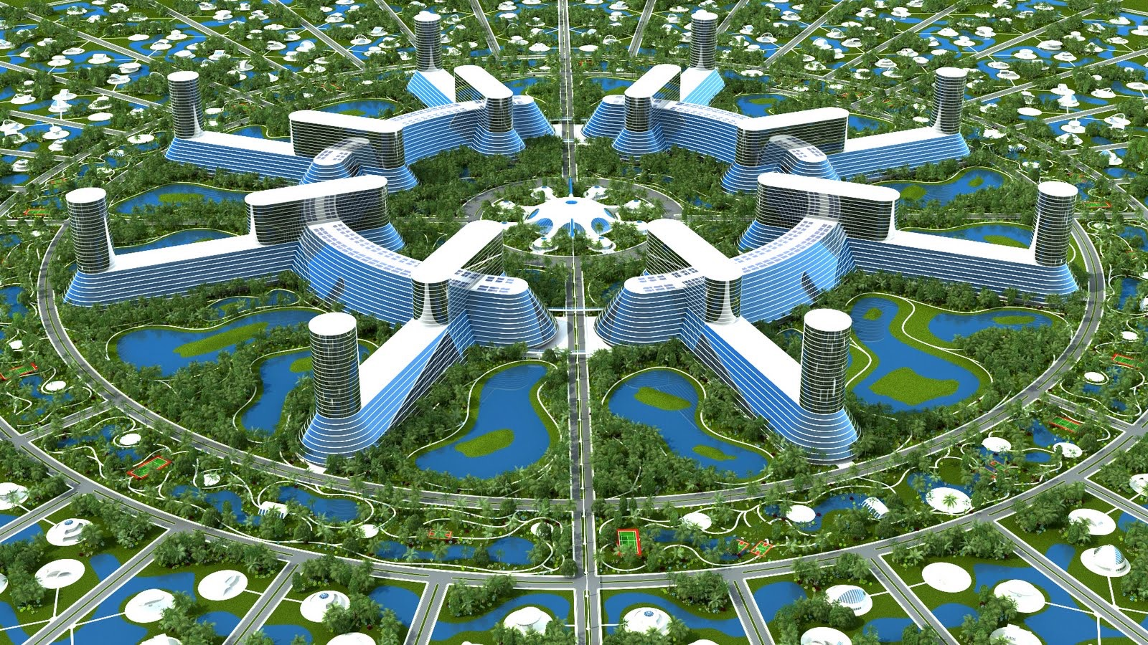
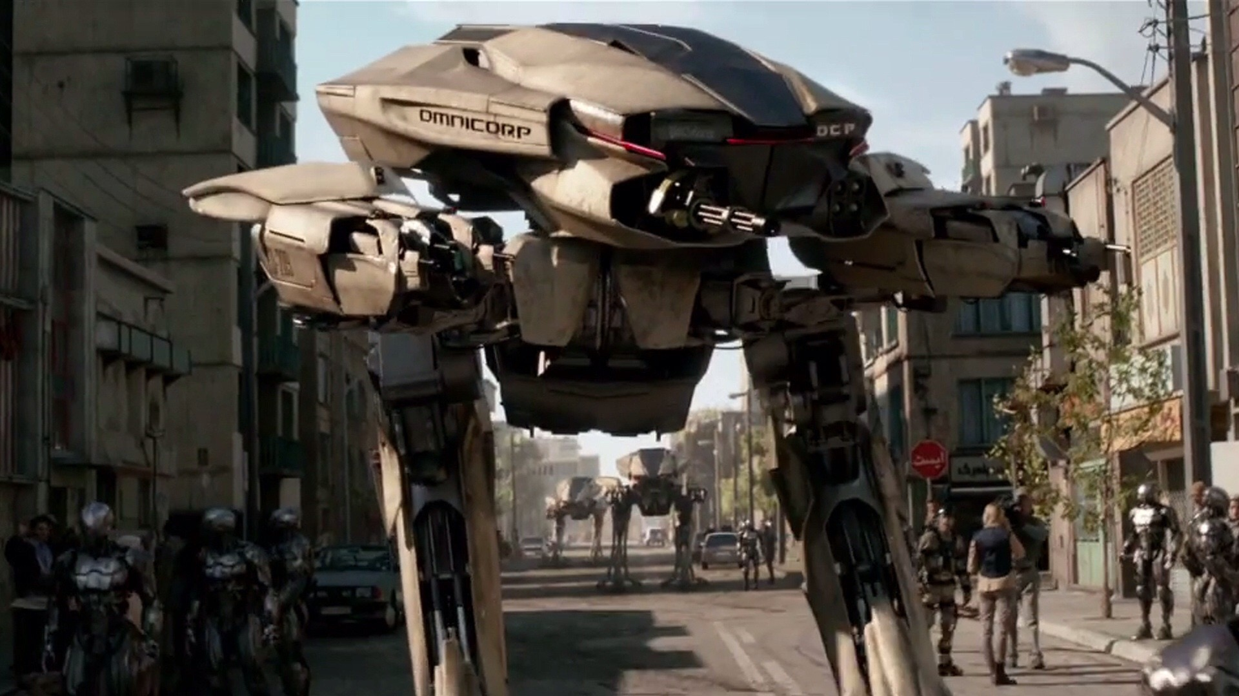

AI futures narratives
Tech utopia
Arms race
Malicious use
Existential risk

Slide 11
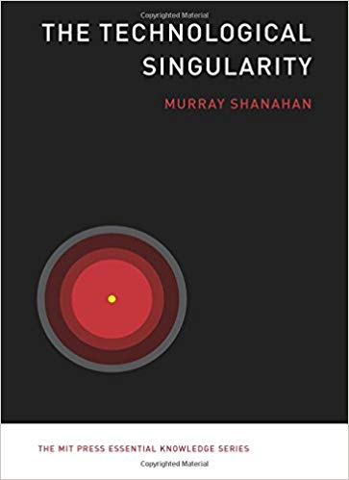

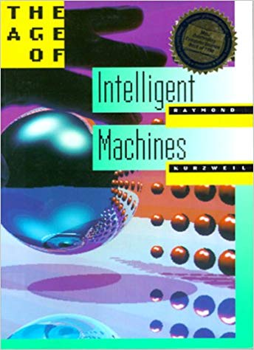
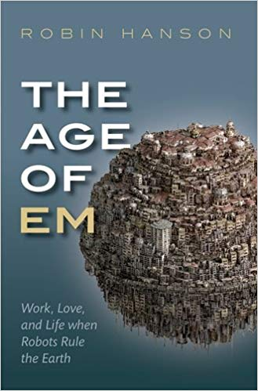
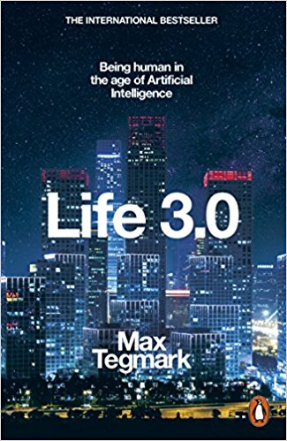
How do we explore and communicate these futures?
Option 1: Single author exploration

Slide 12
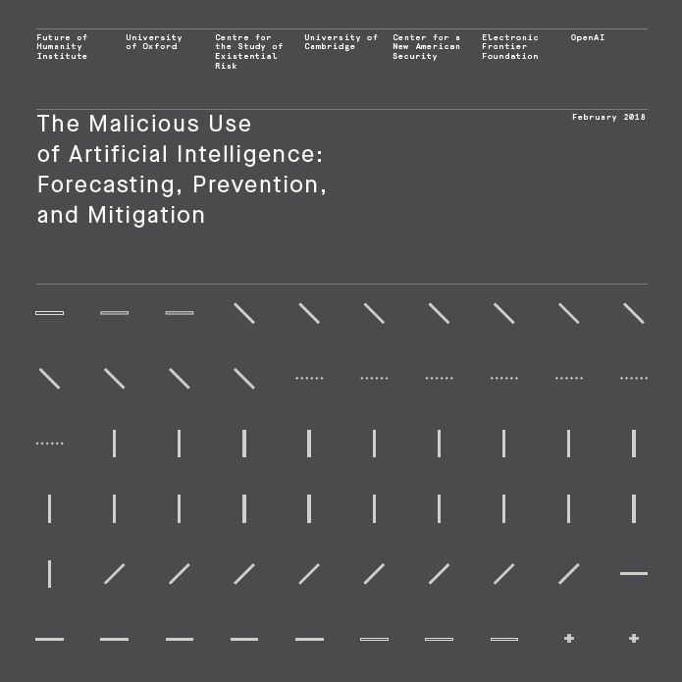
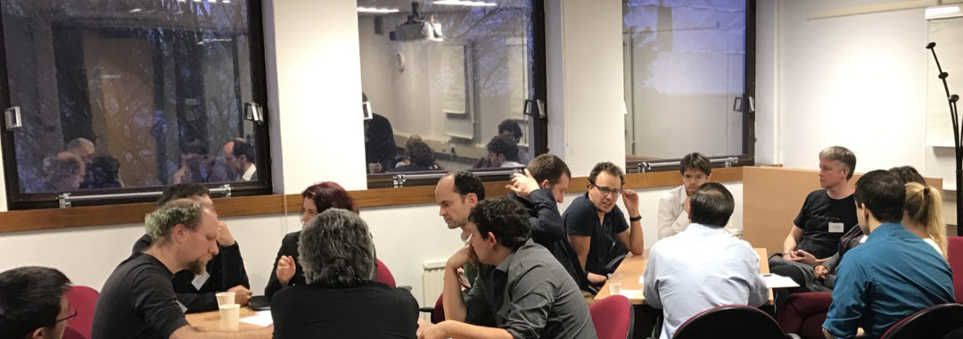
How do we explore and communicate these futures?
Option 2: Expert workshops, multi-authored reports
http://maliciousaireport.com/

Slide 13
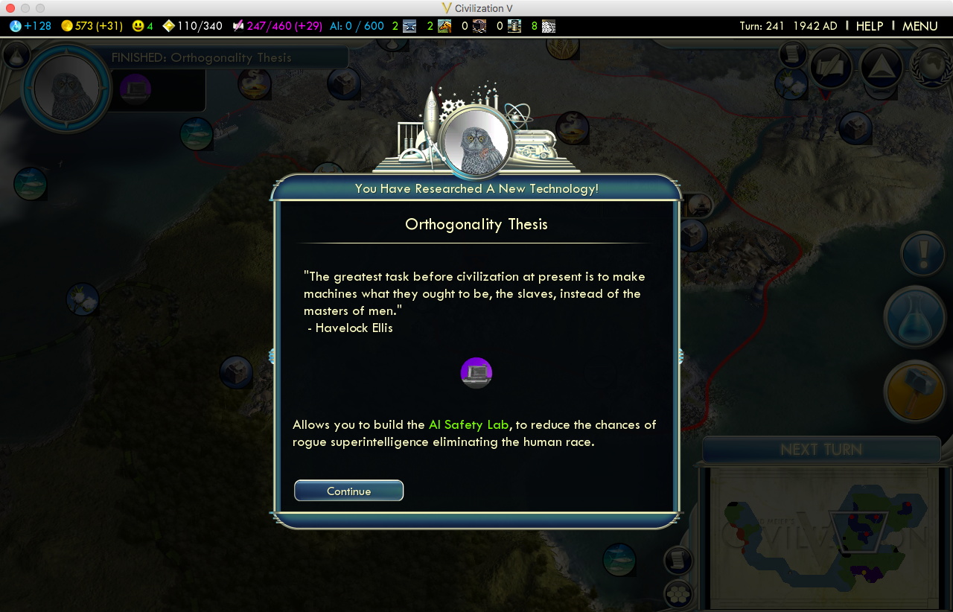
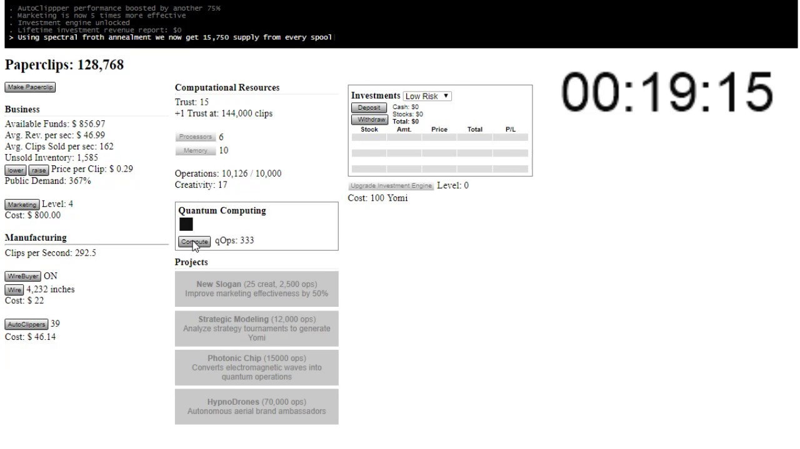
How do we explore and communicate these futures?
Option 3: Interactive media (video games)
https://bit.ly/2uqXNUn
http://www.decisionproblem.com/paperclips/

Slide 14

How do we explore and communicate these futures?
Option 4: Interactive story telling (role playing games)

Slide 15
Shall we play a game?

